Slide 1

PRODUCT
NEXT STEPS
Learnings from Competing in First Hackathon – Nov 1st, 2017

Slide 2

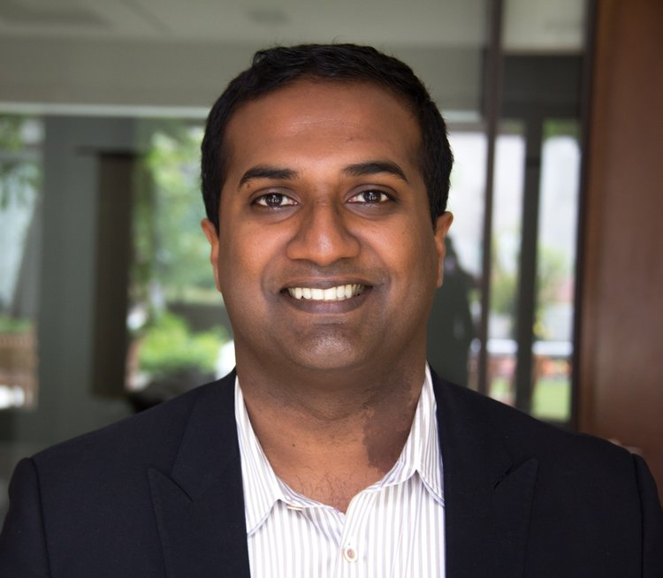

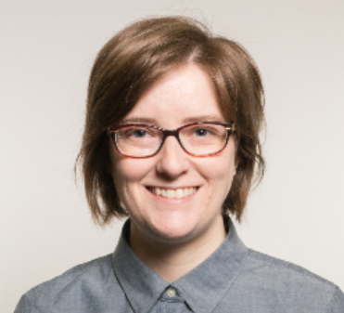

Hackathon Background
Matt Thomas
Co-organizer
CEO of Paddle HR
David Rockefeller fellow
Largest Philanthropy Investment
$500M invested over next 10 years
Preparing young CDN for Future of work
Addressing: experience, skills, and networking gaps
Research & Subject Expertise
Lisa Deacon
Co-organizer
Organizer of Datafest Ottawa
McKinsey
McKinsey Global Institute (MGI), and Centre for Gov (MCG)
Interest in outcome for research
Trilateral Commission
Non-government, policy oriented forum for open dialogue
Interest in solution + judging
INTRO
EVENT
HACK SOLN
LEARNINGS

Slide 3




Hack Schedule + Topics @Ottawa Datafest
Project Topics
Friday, October 13th
6pm – Kickoff
6:30pm – Project Champion Pitches
7pm – Participants circulate + formation of teams
Midnight – Venue closed
PPL + Skill = Match
Training Day
Employee Challenges
Reskill
Mentor Me
Future Jobs
Auto-Vulnerable
Digital Union
I Want To Be
Target: Non Traditional Candidate
Good Decision
Newcomers
Do You Speak Labour Market?
Gig to Live
Workforce Shift
Saturday, October 14th
9am – Venue Opens
1-3pm – End users available
Midnight – Venue closed
Sunday, October 15th
Noon – Hack ends, demos
2pm – Closing remarks
INTRO
EVENT
HACK SOLN
LEARNINGS

Slide 4

Workforce Business Intelligence Tool
Eric, Simon, Trevor, Tony, Yuji, Yuhan
Hack Proj #15: Enterprise WFM
Oct 15th, 2017
INTRO
EVENT
HACK SOLN
LEARNINGS

Slide 5
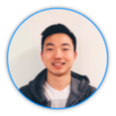
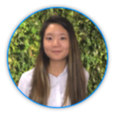
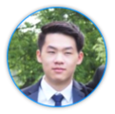
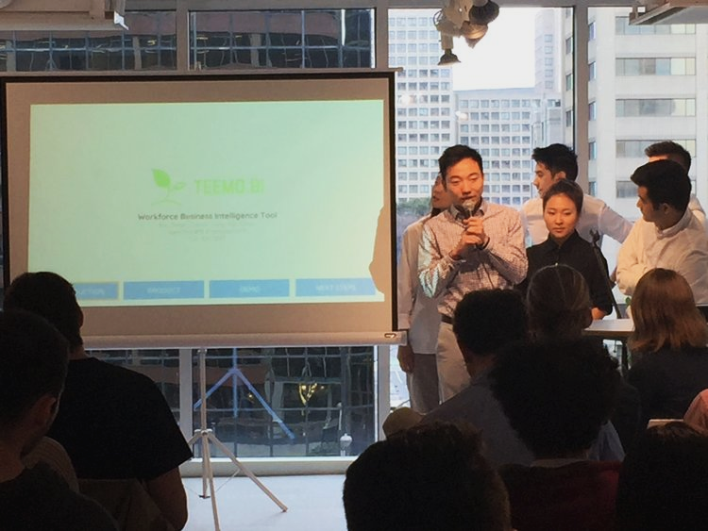



Team
Tony
Proj Lead
Yuhan
Developer
Simon
Developer
Yuji
Statistician
Trevor
Designer
Eric
Designer/Dev
INTRO
PRODUCT
DEMO
NEXT STEPS

Slide 6
Holistic WFM Tool to Navigate the new Automation Wave
Cost Savings from Efficiency Gains
Disruptive Tech Trends
Structural Cost Transformation
Efficiency from automation of workflow
Lean thinking, process improvements & problem solving
-Artificial INTELLIGENCE
-Robotics Process Automation
Human Capital Management
Investments in adaptive skills training, cost severances & outplacements
Better management of talent
-Cognitive Computing
-Advanced Analytics
Opportunities for New Value Adds
Fuel more mid-senior level openings
INTRO
PRODUCT
DEMO
NEXT STEPS

Slide 7
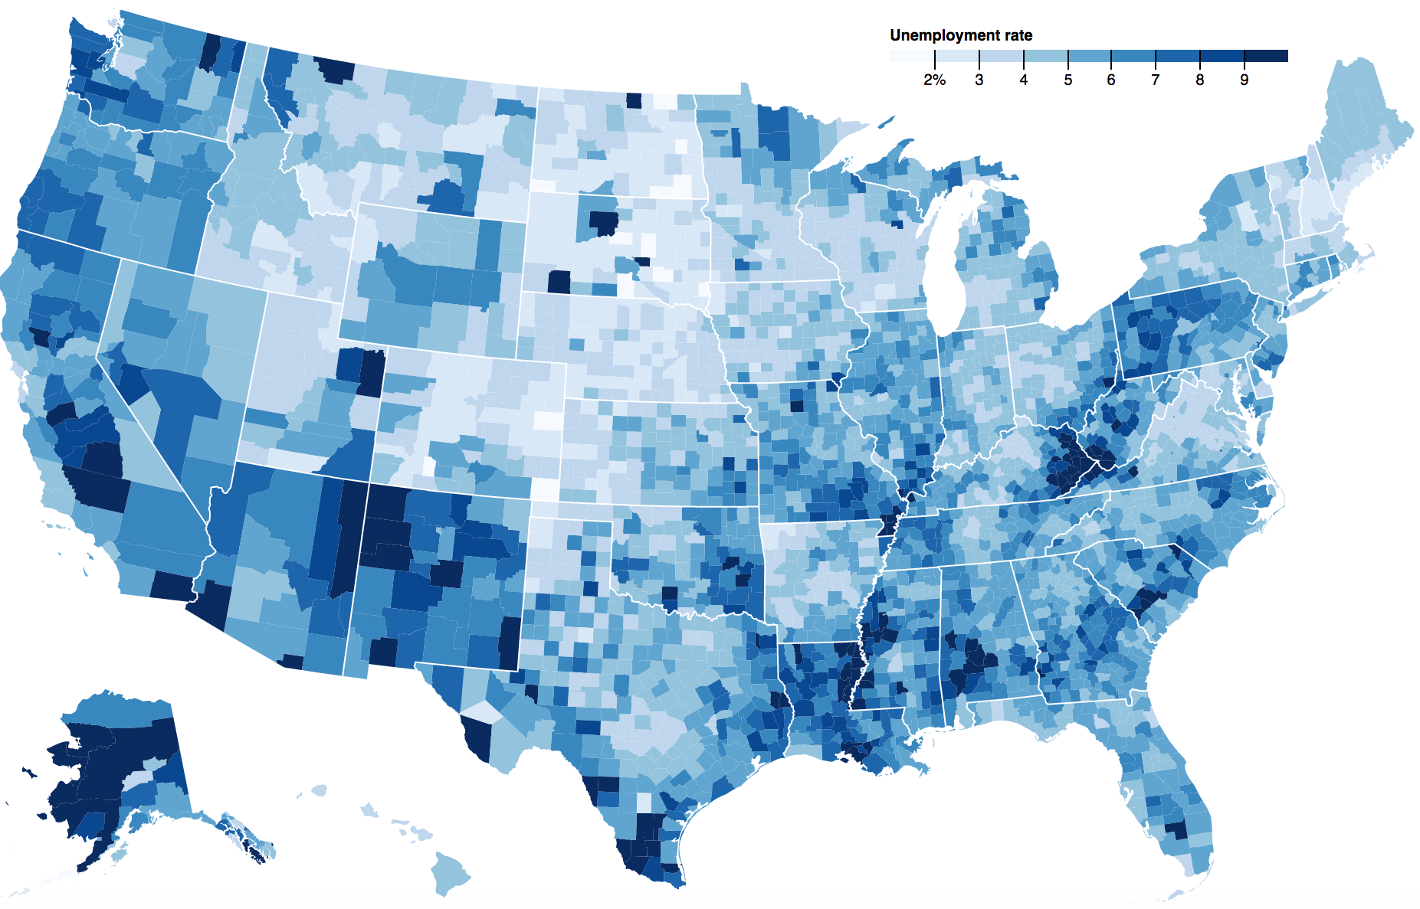
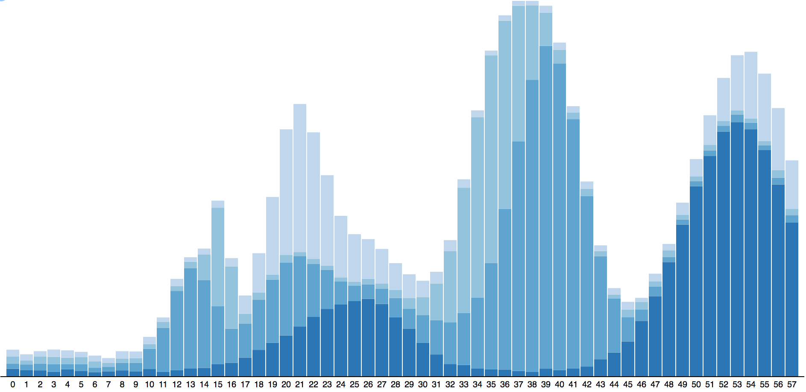
Analytics + Visualization for Improved Decision Making
Features
I
Big Data aggregation from multiple sources
II
Intelligent search engine
III
User friendly UI and Customizations
IV
Interactive Visualizations and Analytics
V
Open source Web API
INTRO
PRODUCT
DEMO
NEXT STEPS

Slide 8
MVP Prototype
It’s not that sexy...
...but it works!
Thank you.
INTRO
PRODUCT
SOLUTION
DEMO
NEXT STEPS

Slide 9



Predictive Analytics from ML Algorithm
Learnings + Improving capabilities
Ingesting from more data sources
POC approach to partner with enterprises
...Any Questions?
INTRO
PRODUCT
DEMO
NEXT STEPS

Slide 10
KEY Learnings
I
Automation’s impact on labour market is a big issue!
Collab of Business & Technical minded people to solve problem
Hackathons are effective if done right
II
III
INTRO
EVENT
HACK SOLN
LEARNINGS

